Slide 1

PRESENTED BY:
JAIDEEP
MAHESH
KAVYA

Slide 2

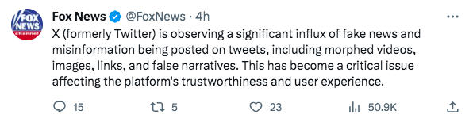
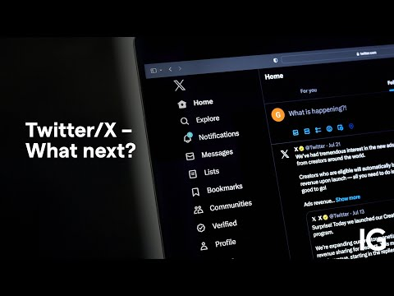
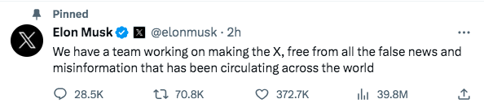
PROBLEM STATEMENT
Metric we will be solving for will be RETENTION - NORTH STAR

Slide 3
_{Advocacy}
Entertainment
X is used to distract oneself from daily pressures of life by engaging in entertaining or humorous content
Information and News
Many users use X to stay updated on current events, news and trending topic
Education
Motivation for
Community & Support
Using
Brand and Product Promotion
Communication
Networking
X is a valuable tool for connecting with peers, colleagues and industry influencer
Businesses, brands, and marketers use Twitter to promote their products and services, engage with customers, and build brand awareness. Users may follow brands for exclusive offers and updates
Through tweets, direct messages and mentions, providing real time communication, X is predominantly used to connect with family, friends and acquaintances

Slide 4
USER INSIGHTS
Based on demography
Based on Intent
Age Age Group | % By Age | %% By Male | % By Females
13-17 | 9.1% | 6.5% | 2.6%
18-24 | 21.6% | 13.6% | 8%
25-34 | 28.9% | 21.4% | 7.5%
35-49 | 28.2% | 20.7% | 7.5%
50 plus | 12.3% | 8.2% | 4.1%
Overall |  | 70.4% | 29.7%
Motivation | % Users
News | 64%
Podcasts | 28%
Video Content | 62%
Networking | 75%
Sharing Content | 82%

Slide 5




USER PERSONAS
Harry
The Knowledge Seeker
Age: 27, Male
Ron
The News Feed Reader
Age: 32, Male
Hermione
The. Social Media influencer
Age: 23, Female
Wants to read relevant news and business updates
Wants to access relevant brands information and update followers
Wants to access relevant content to gain knowledge
FRUSTRATIONS WITH CONTENT
  I have a difficult time finding an article that interests me because of the wide availability of false information.
  I have come across posts with information that had some sensitive content and triggered emotional distress, which later turned out to be a hoax. Now, I’m extremely skeptical to believe the content present on X.
  Due to false information from certain pages pertaining to specific companies' performance, I invested in the wrong stocks, resulting in a huge loss
  Due to these incidents, I am skeptical of all the information available on X and will. always double-check on other platforms
  I come across many fake announcements from pages that look as credible as the original brand pages.
  I find it really hard to differentiate fake news and legit news. There were few instances where i published wrong information to my followers, resulting in depleting of my followers

Slide 6





USER JOURNEY
Scenario : Kay, a 22 year old female, wants to be updated about latest news in entertainment industry.
Expectations : Relevant news, good user experience and credible information.
An official statement by the actor is made disputing the content posted on the profile
Kay is now skeptical to believe the content posted on the profile and unfollows the profile
Kay finds many posts from the profiles she follows making unbelievable news about her favorite actor
Kay finds profiles that perfectly matches her needs
She is upset about the news for days
Kay wants to be a part of community that helps her be updated with latest news on ongoing events in entertainment industry

Slide 7
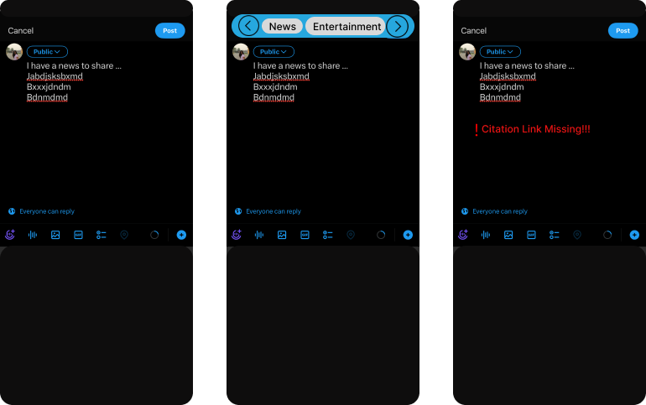
PRODUCT RECOMMENDATION -1
FEATURE - A “Citation Analysis Feature” which will make it mandatory for the users sharing news, research or any cited information tagged to labels - News, Research, etc. to share the valid source link.
INSIGHTS - Twitter is a place a lot of users come to share and consume information, but with Gen AI in full swing, it’s hard to trust the credibility of the platform.
VALUE PROPOSITION TO USERS - This feature will ensure that the users share as well as consume information such as news articles, research papers with a credible source and will help contain spread of misinformation.
SUCCESS METRICS -
DAU’s
Number of posts per user
Average user session time

Slide 8
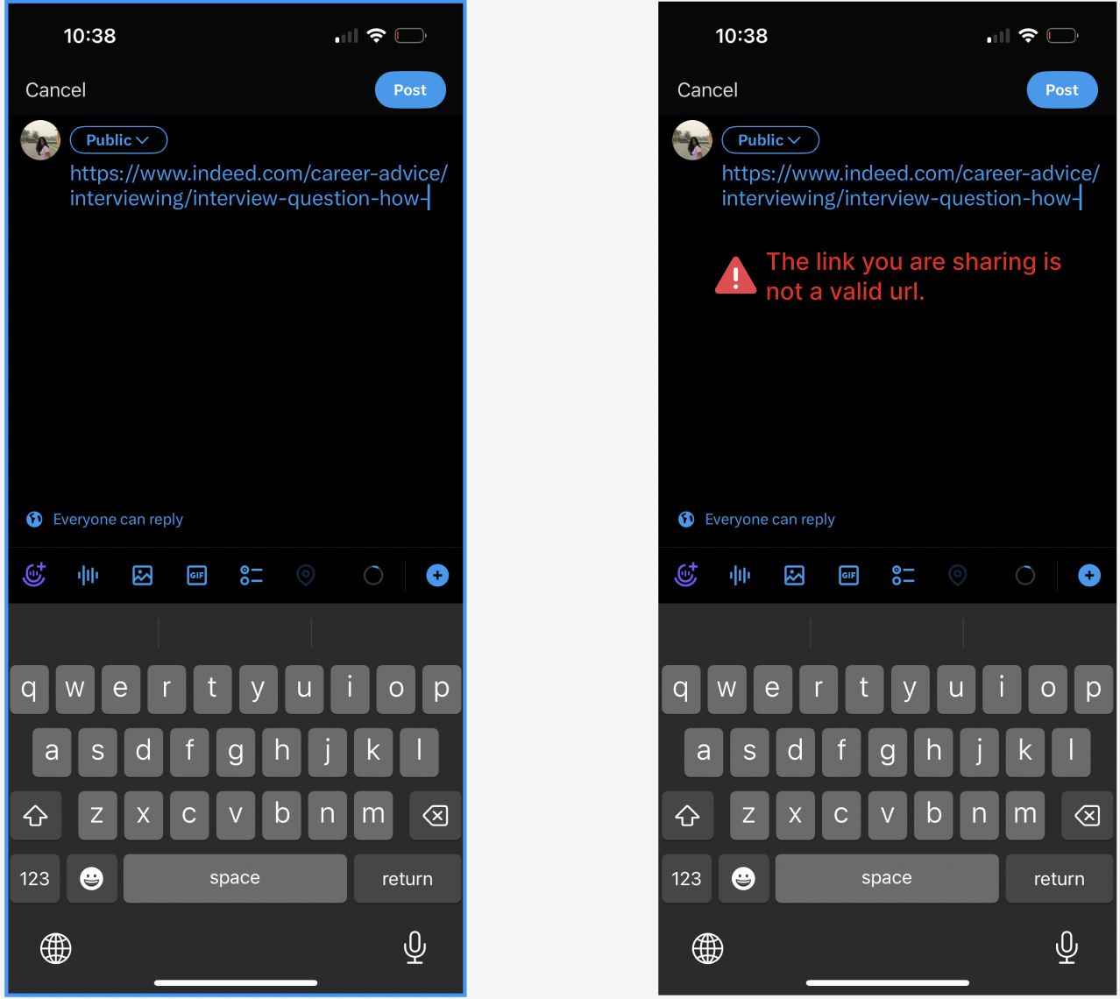
PRODUCT RECOMMENDATION -2
FEATURE - A “Link Checker Feature” which will ensure that the links shared are from trusted or credible sources.
INSIGHTS - While some percentage of users do share the link to certain articles, there is no way to ensure the links are whitelisted or from trusted sources, putting the credibility of the platform on risk.
VALUE PROPOSITION TO USERS - This feature will ensure that the links shared or tweeted are credible, reducing probability of frauds and hence will improve the trust factor of users.
SUCCESS METRICS -
DAU’s
NPS
Reports per user

Slide 9
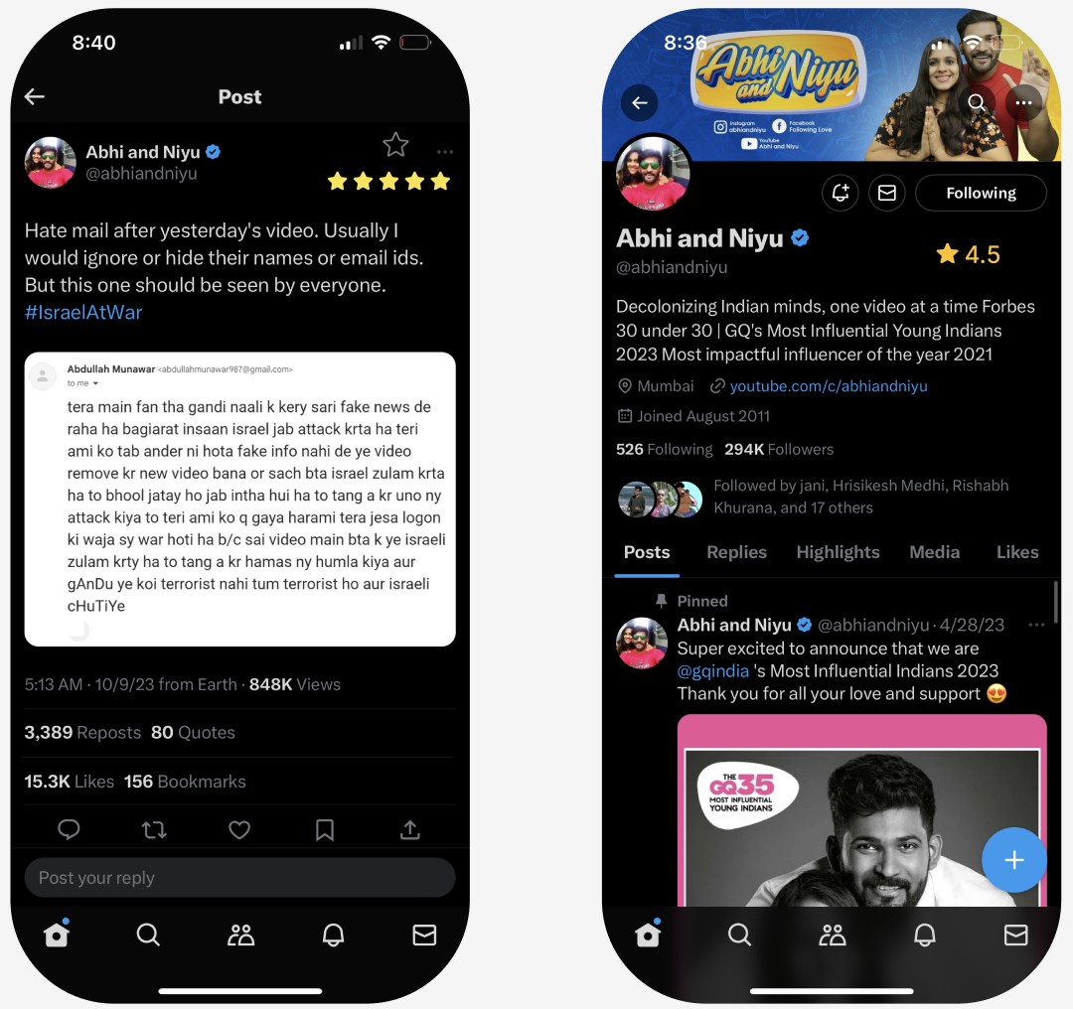
PRODUCT RECOMMENDATION -3
FEATURE - A “user profile rating” feature which will add credibility to a user profile apart from the twitter blue feature.
INSIGHTS - With the monetization of twitter, any premium user can purchase twitter blue and get their profiles verified. This has led to further decline in user trust on platform and increased cases of misinformation.
VALUE PROPOSITION TO USERS - This feature will ensure that the users have a credible way of trusting twitter profiles and choose to follow users or content based on the rating.
SUCCESS METRICS -
Number of clicks on rating feature
Average number of followers per profile
Monthly retention

Slide 10
MOONSHOT FEATURE IDEA 1
MOONSHOT FEATURE IDEA 2
FEATURE - A “Large Language Model” which will be trained on data set to make a prediction if the piece of text is artificially generated, fake or morphed.
FEATURE - A Weekly “Leaderboard Score Feature” across all categories highlighting top 10 credible sources across each categories based on the user rating score.
VALUE PROPOSITION TO USERS - With the help of a large language model, users will be able to navigate mistrusted information and sources better, making it easy for them to consume any information without doubt.
VALUE PROPOSITION TO USERS - With the help of a leaderboard, discovering new credible sources or profiles will become easier and hence bring retention and engagement on the platform.
SUCCESS METRICS -
Churn Rate
DAU’S
MAU’S
Prediction Accuracy scores of LLM
SUCCESS METRICS -
Churn Rate
DAU’S
MAU’S
Increased or decrease in followers of profiles featured on leaderboard.

Slide 11
FEATURE PRIORITIZATION MATRIX
Metrics - Retention and Engagement
High
Large Language Model
Leaderboard feature
Link Checker
User Profile Rating
Citation Analysis
Hard
Easy
Execution - time and resources
Low

Slide 12
THANK YOU!
THANK YOU!

